Slide 1
Lesson: Pointers and Arrays
CSE 4107 : Structured Programming I
Shahriar Ivan

Slide 2
Introduction
C allows us to perform arithmetic—addition and subtraction—on pointers to array elements
This leads to an alternative way of processing arrays in which pointers take the place of array subscripts
The relationship between pointers and arrays in C is a close one
Understanding this relationship is critical for mastering C

Slide 3
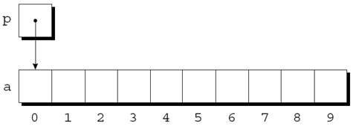
Pointer Arithmetic
Pointers can point to array elements:
int a[10], *p;
p = &a[0];
A graphical representation:

Slide 4
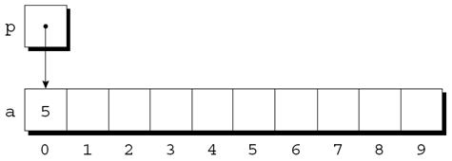
Pointer Arithmetic
We can now access a[0] through p; for example, we can store the value 5 in a[0] by writing
*p = 5;
An updated picture:

Slide 5
Pointer Arithmetic
If p points to an element of an array a, the other elements of a can be accessed by performing pointer arithmetic (or address arithmetic) on p
C supports three (and only three) forms of pointer arithmetic:
– Adding an integer to a pointer
– Subtracting an integer from a pointer
– Subtracting one pointer from another

Slide 6
Pointer Arithmetic
Adding an Integer to a Pointer
Adding an integer j to a pointer p yields a pointer to the element j places after the one that p points to
More precisely, if p points to the array element a[i], then p + j points to a[i+j]
Assume that the following declarations are in effect:
int a[10], *p, *q, i;

Slide 7
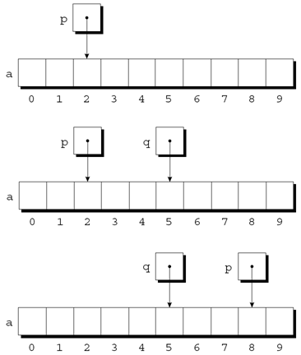
Pointer Arithmetic
Adding an Integer to a Pointer
Example of pointer addition:
p = &a[2];
q = p + 3;
p += 6;

Slide 8
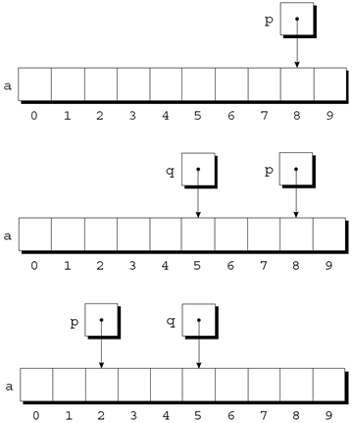
Pointer Arithmetic
Subtracting an Integer from a Pointer
If p points to a[i], then p - j points to a[i-j]
Example:
p = &a[8];
q = p - 3;
p -= 6;

Slide 9
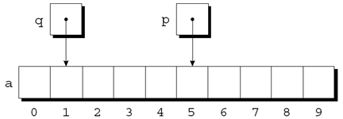
Pointer Arithmetic
Subtracting an Integer from a Pointer
When one pointer is subtracted from another, the result is the distance (measured in array elements) between the pointers
If p points to a[i] and q points to a[j], then p - q is equal to i - j
Example:
p = &a[5];
q = &a[1];
i = p - q; /* i is 4 */
i = q - p; /* i is -4 */

Slide 10
Pointer Arithmetic
Subtracting an Integer from a Pointer
Operations that cause undefined behavior:
– Performing arithmetic on a pointer that doesn’t point to an array element
– Subtracting pointers unless both point to elements of the same array
int a[10], b[10], *p, *q, i, j;
p = &a[0];
i = p - q; /*** WRONG ***/
q = &b[0];
j = p - q; /*** WRONG ***/

Slide 11
Pointer Arithmetic
Comparing Pointers
Pointers can be compared using the relational operators (<, <=, >, >=) and the equality operators (== and !=)
– Using relational operators is meaningful only for pointers to elements of the same array
The outcome of the comparison depends on the relative positions of the two elements in the array
After the assignments
p = &a[5];
q = &a[1];
the value of p <= q is 0 and the value of p >= q is 1

Slide 12
Using Pointers for Array Processing
Pointer arithmetic allows us to visit the elements of an array by repeatedly incrementing a pointer variable
A loop that sums the elements of an array a:
#define N 10
…
int a[N], sum, *p;
…
sum = 0;
for (p = &a[0]; p < &a[N]; p++)
sum += *p;

Slide 13
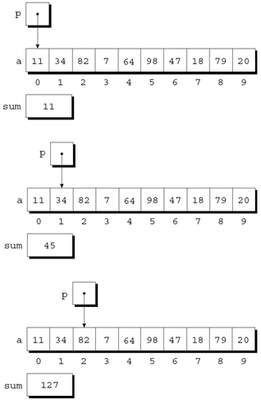
Using Pointers for Array Processing
At the end of the first iteration:
At the end of the second iteration:
At the end of the third iteration:

Slide 14
Using Pointers for Array Processing
The condition p < &a[N] in the for statement deserves special mention
It’s legal to apply the address operator to a[N], even though this element doesn’t exist
Pointer arithmetic may save execution time
However, some C compilers produce better code for loops that rely on subscripting

Slide 15
Using Pointers for Array Processing
Comparing the * and ++ Operators
Modify an array element and advance to the next
*p++ = j; // same as a[i++] = j;
Expression | Meaning
*p++ or *(p++) | Value of expression: *p. Increment p later
(*p)++ | Value of expression: *p. Increment *p later
*++p or *(++p) | Increment p first. Value of expression: *p after increment
++*p or ++(*p) | Increment *p first. Value of expression: *p after increment

Slide 16
Using Array Name as a Pointer
Pointer arithmetic is one way in which arrays and pointers are related
Another key relationship:
The name of an array can be used as a pointer to the first element in the array
This relationship simplifies pointer arithmetic and makes both arrays and pointers more versatile

Slide 17
Using Array Name as a Pointer
Suppose that a is declared as follows:
int a[10];
Examples of using a as a pointer:
*a = 7; /* stores 7 in a[0] */
*(a+1) = 12; /* stores 12 in a[1] */
In general, a + i is the same as &a[i]
– Both represent a pointer to element i of a
Also, *(a+i) is equivalent to a[i]
– Both represent element i itself

Slide 18
Using Array Name as a Pointer
The fact that an array name can serve as a pointer makes it easier to write loops that step through an array
Original loop:
for (p = &a[0]; p < &a[N]; p++)
sum += *p;
Simplified version:
for (p = a; p < a + N; p++)
sum += *p;

Slide 19
Using Array Name as a Pointer
Cannot be assigned a new value
a = p; /*** WRONG ***/
Cannot make it point elsewhere
while (*a != 0)
a++; /*** WRONG ***/
Solution: Copy a into a pointer variable
p = a;
while (*p != 0)
p++;

Slide 20
Programming Task
Reversing a Series of Numbers (Revisited)
The reverse.c program of Chapter 8 reads 10 numbers, then writes the numbers in reverse order
The original program stores the numbers in an array, with subscripting used to access elements of the array
reverse3.c is a new version of the program in which subscripting has been replaced with pointer arithmetic

Slide 21
Using Array Name as a Pointer
C allows us to subscript a pointer as though it were an array name:
#define N 10
…
int a[N], i, sum = 0, *p = a;
…
for (i = 0; i < N; i++)
sum += p[i];
**The compiler treats p[i] as *(p+i)

Slide 22
Array Arguments (Revisited)
When passed to a function, an array name is treated as a pointer
A call of find_largest:
largest = find_largest(b, N);
This call causes a pointer to the first element of b to be assigned to a;
int find_largest(int a[], int n){
int i, max;
max = a[0];
for (i = 1; i < n; i++)
if (a[i] > max)
max = a[i];
return max;
}

Slide 23
Array Arguments (Revisited)
As opposed to ordinary variables, when array is passed
– Pointer is passed instead of copying
– Editing array variable can change array in argument
To prevent change, use const
int find_largest(const int a[], int n);
void store_zeros(int a[], int n){
int i;
for (i = 0; i < n; i++)
a[i] = 0;
}

Slide 24
Array Arguments (Revisited)
The time required to pass an array to a function doesn’t depend
on the size of the array ⇒ No copy is made
An array parameter can be declared as pointer ⇒ Compiler
treats them as identical
int find_largest(int *a, int n);
Not the same for variable declaration
– Sets aside space for 10 integers int a[10];
– Allocates space for a pointer variable int *a;

Slide 25
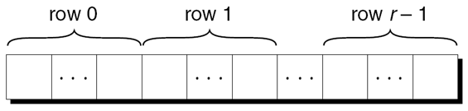
Pointers and Multidimensional Arrays
Processing the Elements of a Multidimensional Array
Just as pointers can point to elements of one-dimensional arrays, they can also point to elements of multidimensional arrays
Layout of an array with r rows:
If p initially points to the element in row 0, column 0, we can visit every element in the array by incrementing p repeatedly

Slide 26
Pointers and Multidimensional Arrays
Processing the Elements of a Multidimensional Array
Consider the problem of initializing all elements of the following array to zero:
int a[NUM_ROWS][NUM_COLS];
The obvious technique would be to use nested for loops:
int row, col;
…
for (row = 0; row < NUM_ROWS; row++)
for (col = 0; col < NUM_COLS; col++)
a[row][col] = 0;

Slide 27
Pointers and Multidimensional Arrays
Processing the Elements of a Multidimensional Array
If we view a as a one-dimensional array of integers, a single loop is sufficient:
Works with most C compilers
int *p;
…
for (p = &a[0][0]; p <= &a[NUM_ROWS-1][NUM_COLS-1]; p++)
*p = 0;

Slide 28
Pointers and Multidimensional Arrays
Processing the Rows of a Multidimensional Array
A pointer variable p can also be used for processing the elements in just one row of a two-dimensional array
To visit the elements of row i, we’d initialize p to point to element 0 in row i in the array a:
p = &a[i][0];
or we could simply write,
p = a[i];

Slide 29
Pointers and Multidimensional Arrays
Processing the Rows of a Multidimensional Array
int A[2][3];
A[0], A[1] will be 1D-arrays of 3 integers
So, we can not write, int *p = A;
int (*)p[3] = A;
Here, A &A[0]
*A A[0] &A[0][0]
A+1 &A[1]
*(A+1) A[1] &A[1][0]
*(A+1)+2 A[1]+2 &A[1][2]
A[0]
1 | 2 | 3
4 | 5 | 6
A[1]

